Slide 1
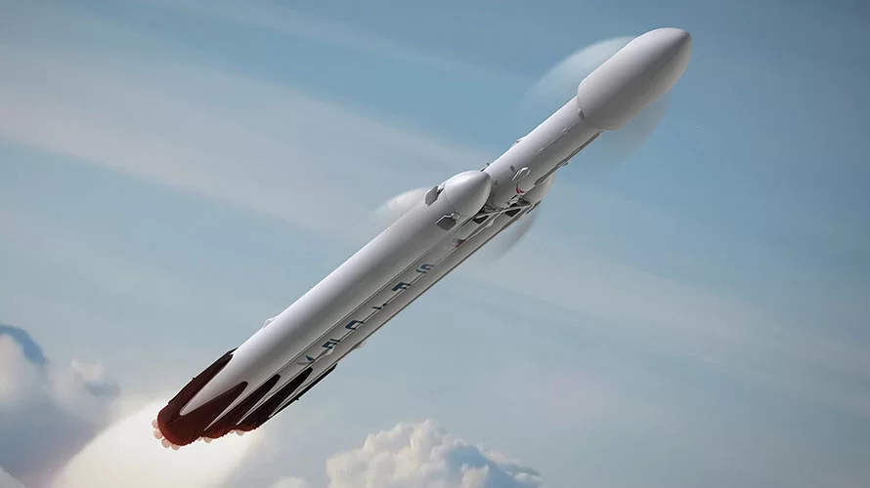
Data Science Capstone - Falcon9 Landing Prediction
Soubhagya Ranjan Das
2022-08-27

Slide 2

Outline
Executive Summary
Introduction
Methodology
Results
Conclusion
Appendix

Slide 3
Executive summary
Methodologies:
Data is collected using web scraping and SpaceX API.
EDA, Data wrangling, Data Visualization, Interactive Visual analytics are done.
Predictive analysis
Summary:
Through the EDA process, the features best suited to predict the success of launchings are identified.
Predictive analysis was done based on different ML models.

Slide 4
Introduction
Context:
SpaceX advertises Falcon9 rocket launches at a cost of $62 million, while other providers cost upward $165 million, as SpaceX can reuse the stage 1.
Therefore, if we can predict if stage1 will land we can predict the launch cost.
This information can be used if any competitor wants to bid for rocket launch.
The goal is to create a ML model to predict if stage1 will land or crash.
Answers we want:
What factors lead to successful landing of rocket.
Relationship between the rocket features and the success/fail outcome.
Success rate based on location.

Slide 5

METHODOLOGY

Slide 6
Methodology: Overview
Data Collection Methodology:
Data is collected using SpaceX API and scraping data from Wikipedia website.
Data Wrangling:
Collected data was enriched by creating a landing outcome label based on outcome data after summarizing and analyzing features.
Exploratory Data Analysis (using SQL and Data Visualization):
The data was explored as to how much different features are impacting the final outcome of the launch, whether the stage1 is landed successfully or failed.
Impact of Payload mass, Orbit etc. on the outcome.

Slide 7
Methodology: Overview
Feature Engineering
Features that will be used in success prediction will be extracted and dummy variables for the categorical variables are created.
Interactive Visualization:
Using Plotly and Dash, the visual analytics are done.
Predictive Analytics:
Different models were used for the prediction of landing success and models were tuned and errors were evaluated.

Slide 8
Methodology: Data Collection via SpaceX API
Getting Response from SpaceX API
Converting response to .json file
Applying Custom Functions to clean data
Creating dictionary from the list of data from custom functions.
Creating a dataframe from dictionary and filter out only Falcon9 data.

Slide 9
Methodology: Data Collection via scraping
Getting Response from HTML and creating BeautifulSoup Object
Finding and extracting table and its columns.
Creating a DataFrame from parsing the extracted HTML tables

Slide 10
Methodology: Data Wrangling
Process refers to cleaning and unifying messy and complex datasets for analysis and exploration.
Missing values were replaced with the mean value.
New column is created in the dataset based on the column ‘Outcome’ which will ultimately be the dependent variable (or the success/fail criteria)

Slide 11
Methodology: EDA using SQL
The following SQL queries were performed:
Names of the unique launch sites in the space mission.
Top 5 launch sites whose name begin with the string 'CCA’.
Total payload mass carried by boosters launched by NASA (CRS).
Average payload mass carried by booster version F9 v1.1
Date when the first successful landing outcome in ground pad was achieved
Names of the boosters which have success in drone ship and have payload mass between 4000 and 6000 kg
Total number of successful and failure mission outcomes.
Names of the booster versions which have carried the maximum payload mass.
Failed landing outcomes in drone ship, their booster versions, and launch site names for in year 2015.
Rank of the count of landing outcomes (such as Failure (drone ship) or Success (ground pad)) between the date 2010-06-04 and 2017-03-20.

Slide 12
Methodology: EDA using visualization
Scatter Graph (Class)
Payload vs Flight Number
Flight Number vs Launch Site
Bar Graph
Success rate of each orbit type
Line Plot
Success trend in each year
Payload vs Launch Site
Flight Number vs Orbit type
Payload vs Orbit type

Slide 13
Methodology: EDA Interactive Map
All the launch sites were marked on the map.
The success and failed launches were marked for each site on the map.
The distance between the launch site and its proximities are calculated and marked on the map.

Slide 14
Methodology: Feature Engineering
The important features which are used for defining the success/failure of launch are selected for the further process.
The categorical variables are one-hot encoded so that we can process these variables in the model.
All the numeric columns are converted to float.

Slide 15
Methodology: Predictive Analysis (Classification)
The model were built on 4 different ML models (Logistic Regression, SVM, Decision Tree, KNN) and the best parameter were find out based on hyperparameter tuning.
Splitting Dataset into dependent and independent variable.
The independent variables are standardized and split into training and test set
Different models are built and tuned.
The best model is found out using the best accuracy score.

Slide 16

RESULTS

Slide 17
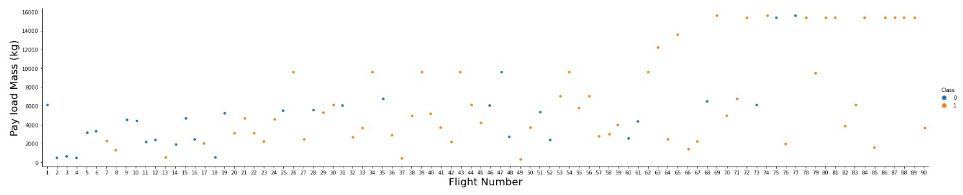
RESULTS: Visualization Results
Payload vs Flight Number:
As the flight number increases, the first stage is more likely to land successfully.
The payload mass is also important; it seems the more massive the payload, the less likely the first stage will return.

Slide 18
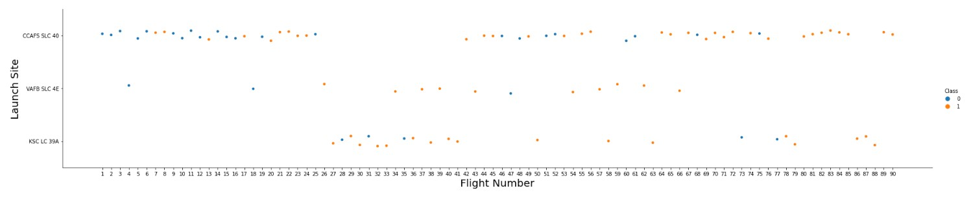
RESULTS: Visualization Results
Flight Number vs Launch Site
With higher flight number, the success rate of rockets are increasing.
The best launch site nowadays is CCAF5 SLC 40, where most of recent launches were successful.

Slide 19
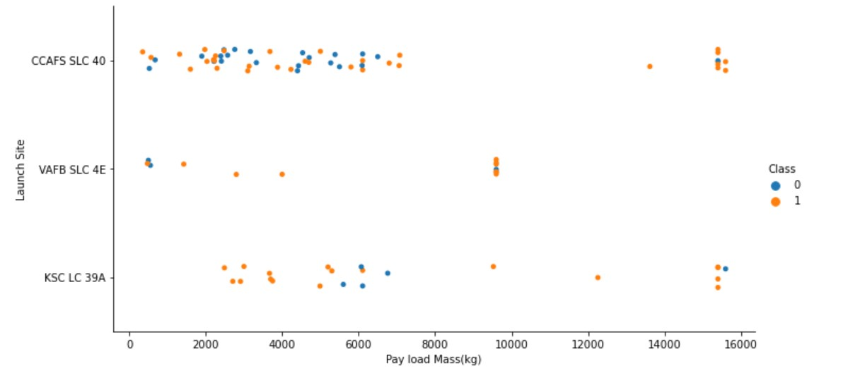
RESULTS: Visualization Results
Payload vs Launch Site
Payloads over 9,000kg (about the weight of a school bus) have excellent success rate

Slide 20
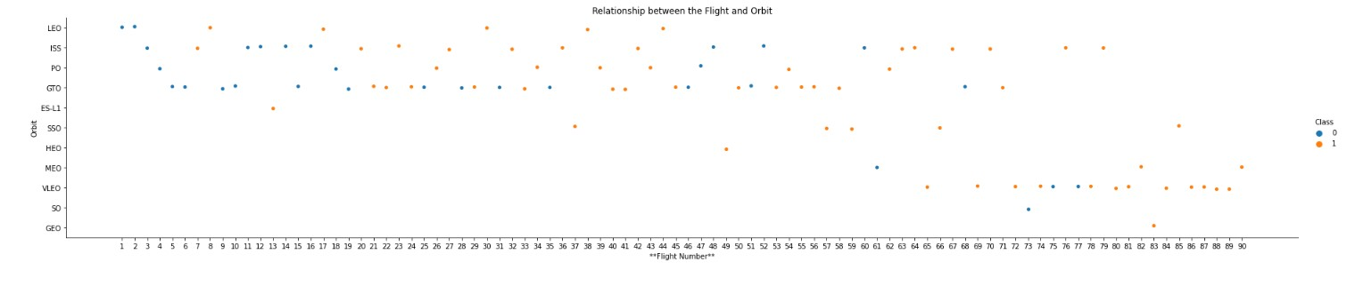
RESULTS: Visualization Results
Flight Number vs Orbit

Slide 21
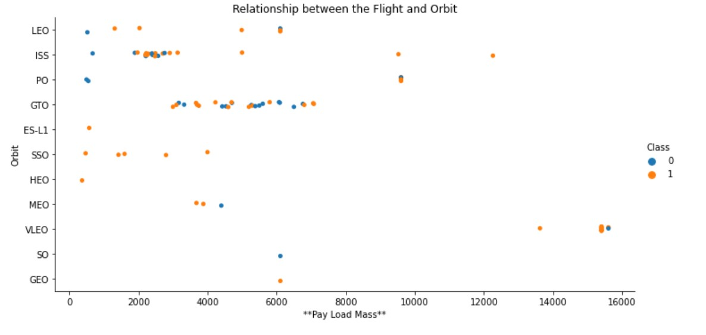
RESULTS: Visualization Results
Payload vs Orbit

Slide 22
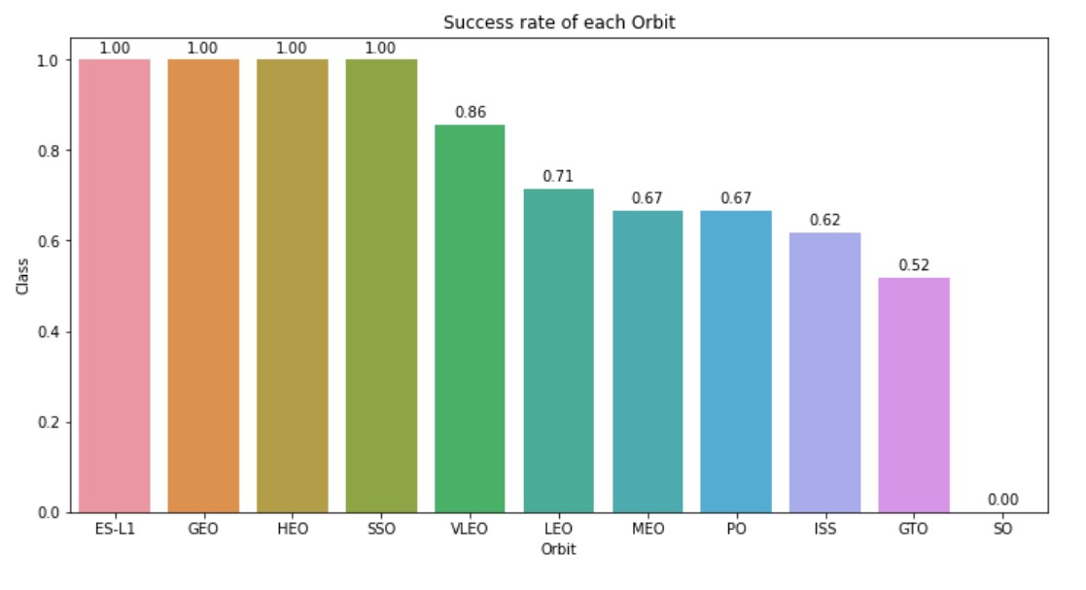
RESULTS: Visualization Results
Success rate of Orbit

Slide 23
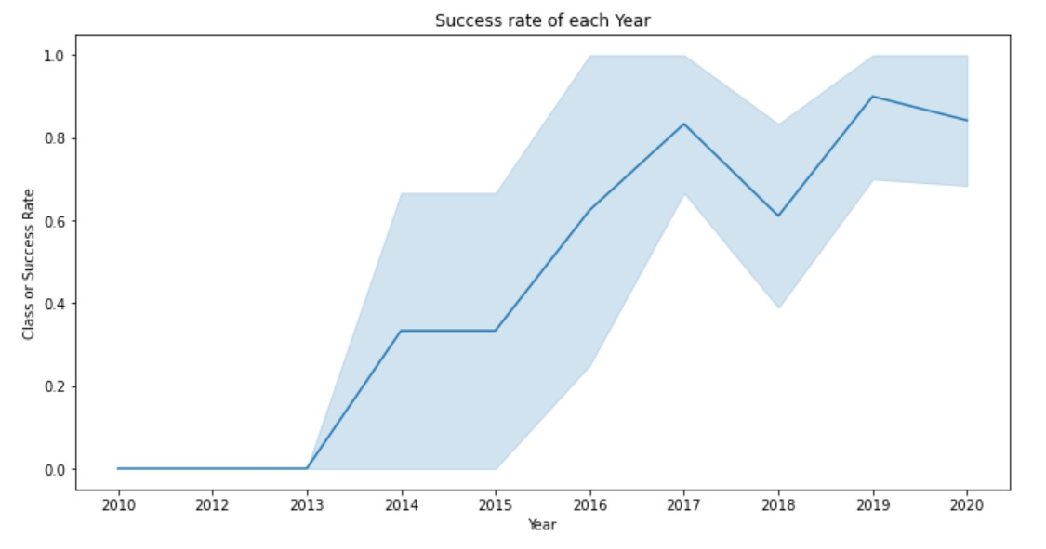
RESULTS: Visualization Results
Success Yearly Trend

Slide 24
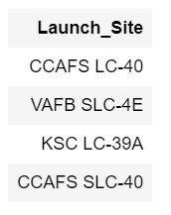
RESULTS: From SQL
Different launch sites for the launch of rockets:

Slide 25

RESULTS: From SQL
Total payload mass carried by boosters launched by NASA (CRS)

Slide 26

RESULTS: From SQL
Average payload mass carried by booster F9 v1.1

Slide 27

RESULTS: From SQL
First successful landing outcome in ground pad

Slide 28
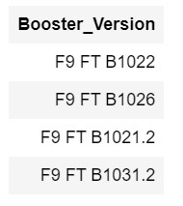
RESULTS: From SQL
Boosters which have success in drone ship having payload mass between 4000 kg and 6000 kg

Slide 29
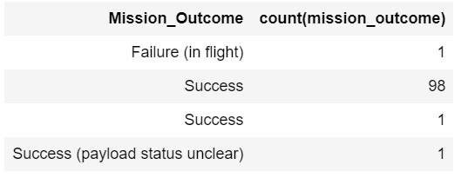
RESULTS: From SQL
Total number of successful and failed outcomes
From the table below, we can see that there are 100 successful landings

Slide 30
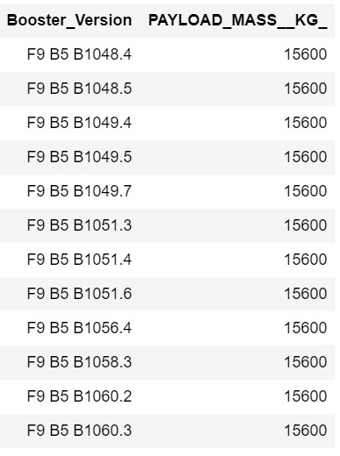
RESULTS: From SQL
Boosters which have carried maximum payload:

Slide 31
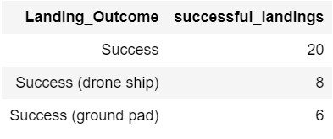
RESULTS: From SQL
Successful landing outcomes between 04-06-2010 and 20-03-2017

Slide 32
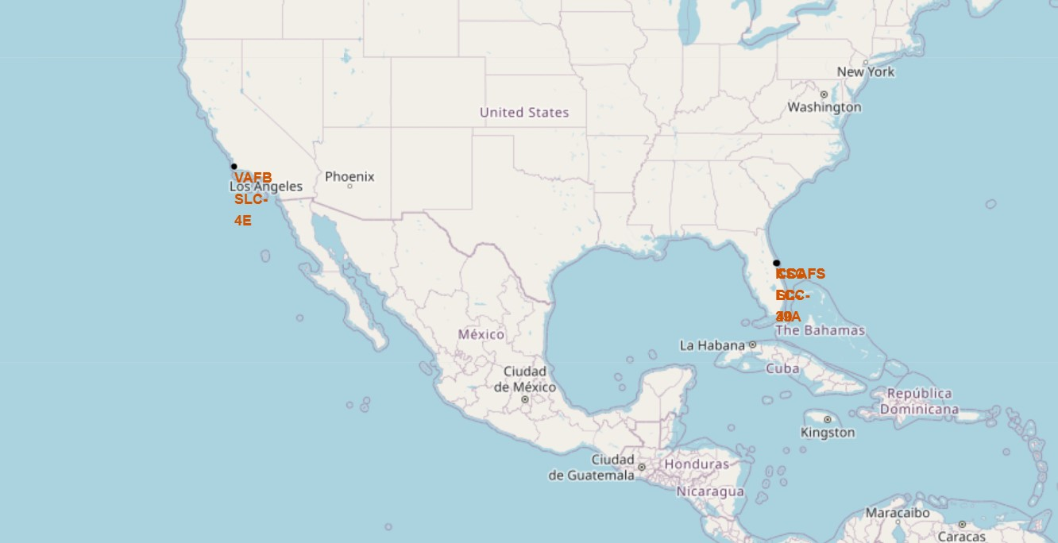
RESULTS: Interactive visualization in map
All Launch sites:

Slide 33
RESULTS: Interactive visualization in map
Success/Failed launches at each site
We can see that KSC LC-39A site have a lot of successful landings.
Green marker – Success
Red marker – Failed
VAFB SLC-4E
KSC LC-39A
CCAFS SLC-40
CCAFS LC-40

Slide 34
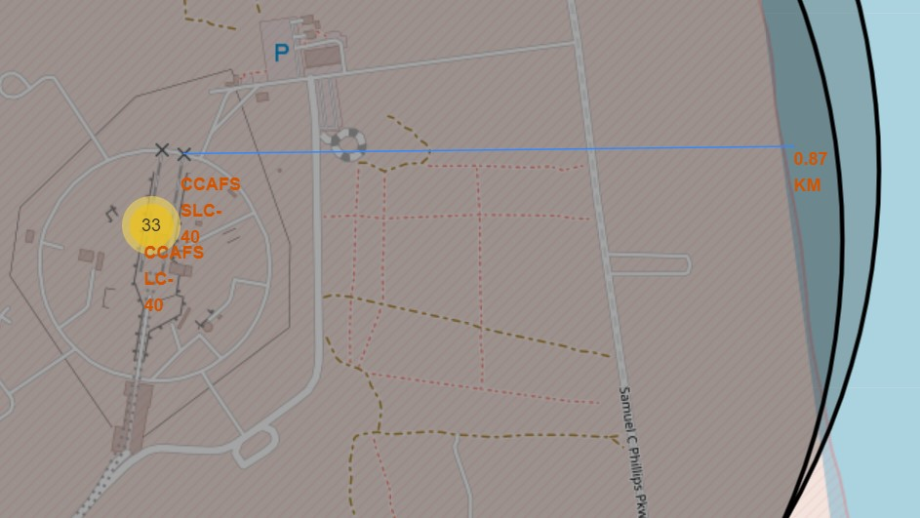
RESULTS: Interactive visualization in map
Distance to nearest coastline:
All the launch sites are situated near to the coastlines.

Slide 35
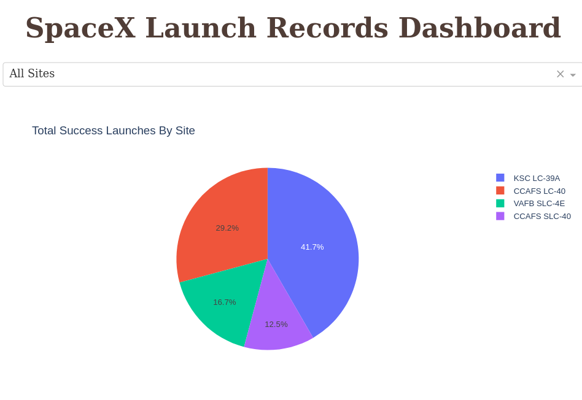
RESULTS: Dashboard

Slide 36
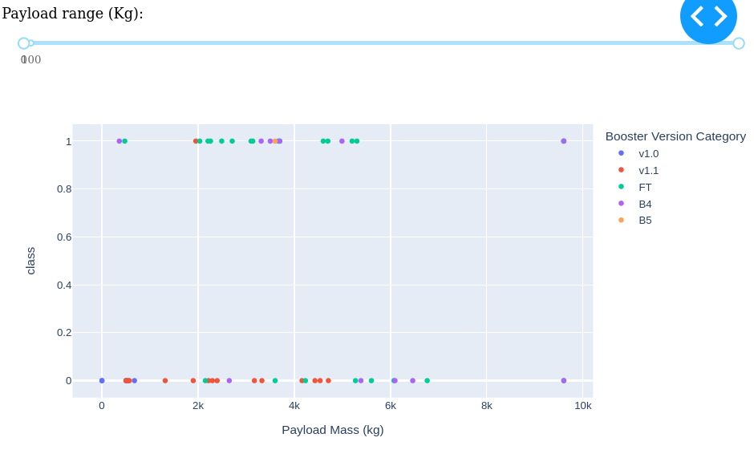
RESULTS: Dashboard

Slide 37
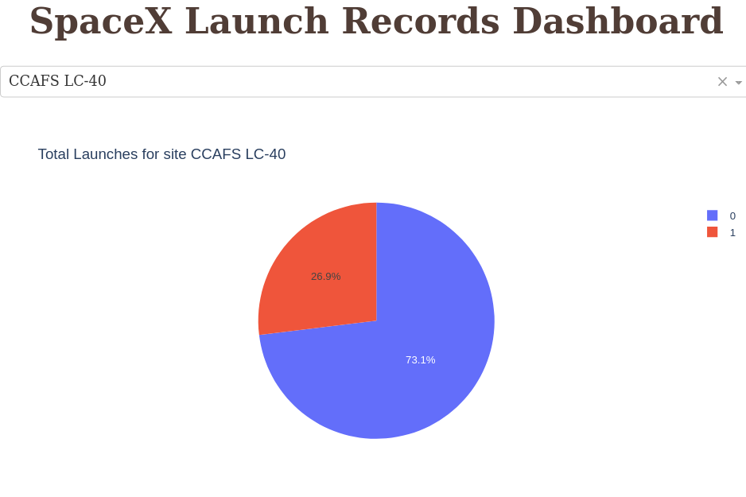
RESULTS: Dashboard

Slide 38
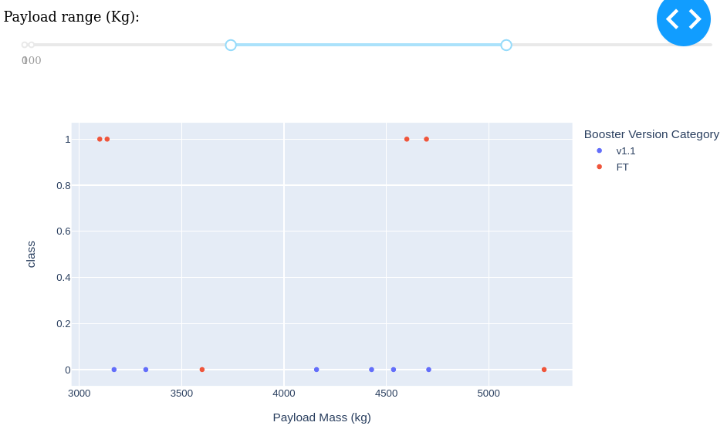
RESULTS: Dashboard

Slide 39
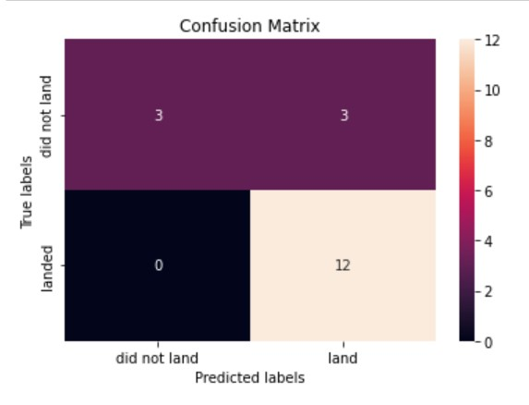
RESULTS: Predictive Analysis
Confusion Matrix:
The confusion matrix yielded by all the models is same

Slide 40
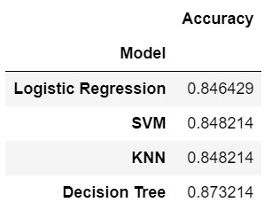
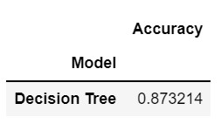
RESULTS: Predictive Analysis
Classification Accuracy
The models are built using the best parameters and we get the best score based on that.
We’ve looked at 4 different machine learning algorithms and the test accuracy have been calculated.
The Decision Tree model gave the best result among all other models.

Slide 41


Slide 42
CONCLUSION
Orbits ES-L1, GEO, HEO and SSO has the highest successful landing rate.
Success rates for SpaceX launches has been increasing with time.
KSC LC-39A has the most successful launches but increasing payload mass can have negative impact on landing.
Although most of mission outcomes are successful, successful landing outcomes seem to improve over time, according the evolution of processes and rockets.
Decision Tree algorithm turned out to be the best algorithm to predict the successful landings and reduce the amount of next rocket launch.

Slide 43
APPENDIX
We can try other models and look if our model can get improved.
Github link for the codes: IBM-Capstone

Slide 44


